Slide 1

HEALTH AND FITNESS

Slide 2
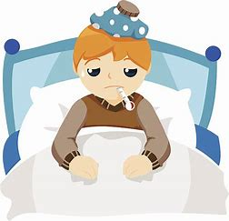
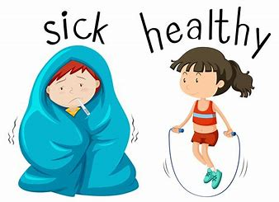
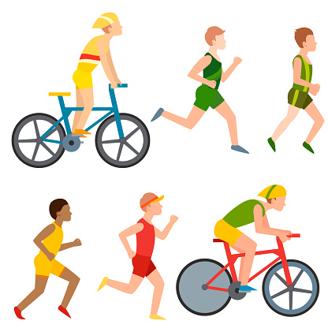
HEALTH
Health and fitness are important in every day living, and being healthy means more than not being ill or sick.
There are many parts of a persons life which contributes to their good health

Slide 3

ASPECTS OF HEALTH

Slide 4
FITNESS
Fitness is a measure of the body's ability to complete those activities necessary for everyday life effectively and efficiently.
Careful measurement of fitness can help to improve performance and ability.

Slide 5
SO WHAT IS FITNESS?
BASICALLY IT IS HAVING A HIGHLY EFFICIENT BODY WHICH CAN COPE WITH A HIGH LEVEL OF PHYSICAL DEMANDS.
DIFFERENT ACTIVITIES MAKE DIFFERENT DEMANDS-FOR EXAMPLE, A MARATHON RUNNER WHO CAN RUN 26 MILES MAY HAVE DIFFICULTY WITH THE DEMANDS OF SQUASH OR WEIGHT LIFTING.

Slide 6
WHAT MAKES SOMEONE FIT?
NOT THESE
FOUR S'S
AGE
SEX
POWER
STRENGTH
SUPPLENESS (FLEXIBILITY)
STAMINA (ENDURANCE)
SPEED

Slide 7
PHYHSICAL FITNESS
INFORMATION ABOUT PHYSICAL FITNESS
PS:
Physical fitness is the ability of the heart, lungs, muscles and joints to perform well.
Regular physical activity promotes physical fitness.
Power
Speed
Stamina (endurance)
Strength
Suppleness (flexibility)

Slide 8
SKILL RELATED FITNESS
INFORMATION ABOUT SKILL RELATED FITNESS
PS:
Skill related fitness is the ability to perform skills used in sport and physical activities.
They can help you improve your overall performance in sport and games.
BALANCE
CO-ORDINATION
REACTION TIME
AGILITY

Slide 9
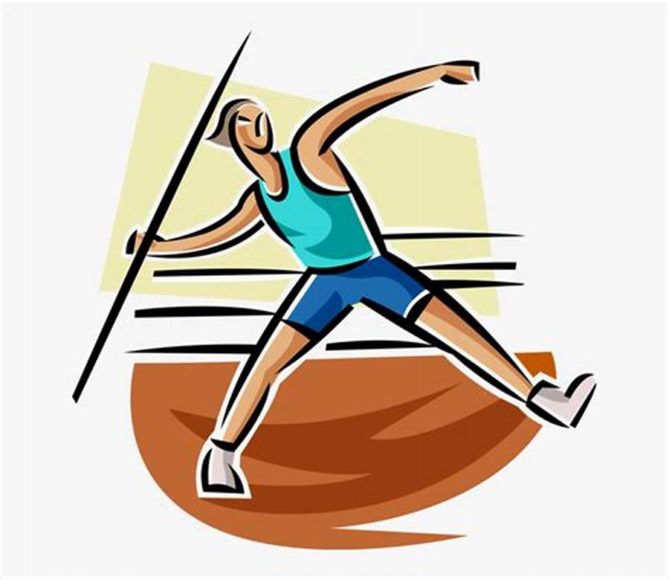
POWER
POWER IS A COMBINATION OF STRENGTH AND SPEED.
NEEDED FOR EXPLOSIVE ACTIONS.

Slide 10

CARDIO-RESPIRATORY STAMINA OR ENDURANCE THIS IS THE ABILITY OF THE WHOLE BODY TO WORK CONTINUOUSLY.

Slide 11
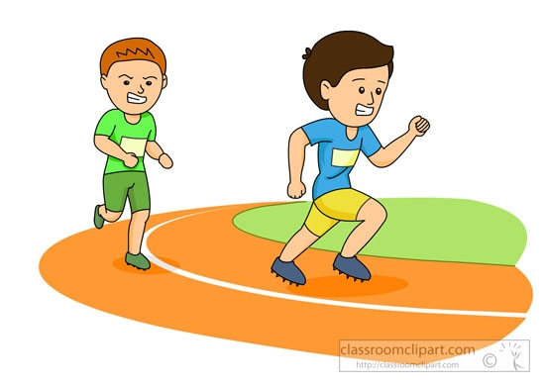
SPEED
THIS IS THE ABILITY TO COVER DISTANCE OR CREATE A MOVEMENT IN A SHORT TIME.
THIS ABILITY IS AN IMPORTANT PART OF MOST SPORTS.

Slide 12
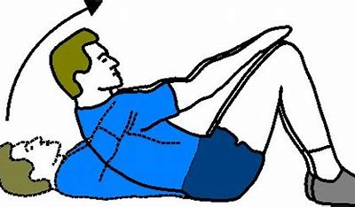
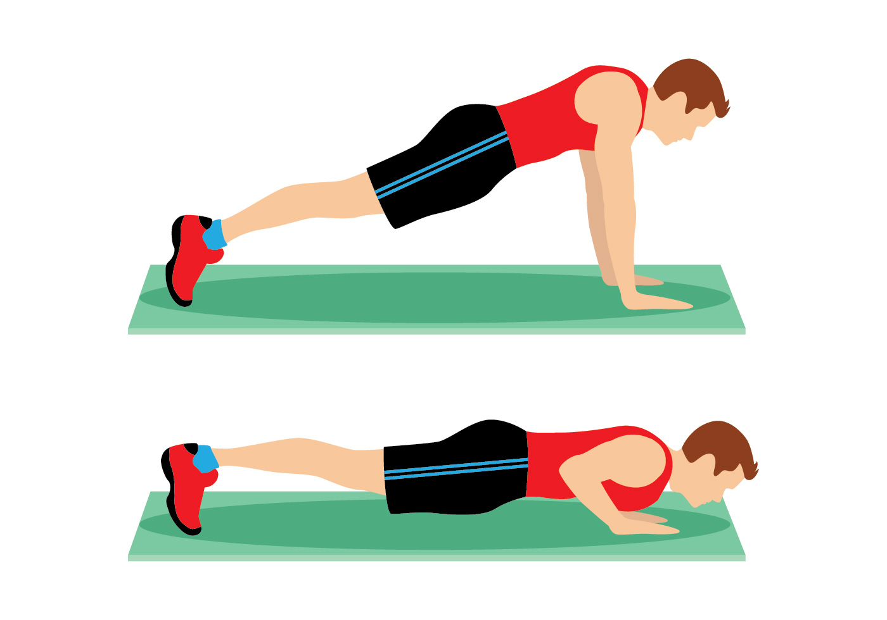
MUSCULAR ENDURANCE
IS THE ABILITY OF A MUSCLE OR GROUP OF MUSCLES TO CONTRACT FOR AN EXTENDED PERIOD OF TIME.

Slide 13
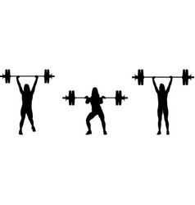
STRENGTH
THE ABILITY OF A MUSCLE OR GROUP OF MUSCLES TO ECHERT A FORCE AS THEY CONTRACT.
THERE ARE THREE TYPES OF STRENGTHS
DYNAMIC
EXPLOSIVE
STATIC

Slide 14
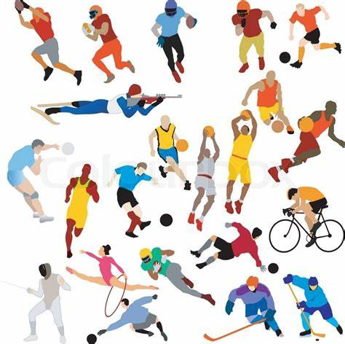
TYPES OF FITNESS

Slide 15
THANK YOU

